Slide 1


Slide 2
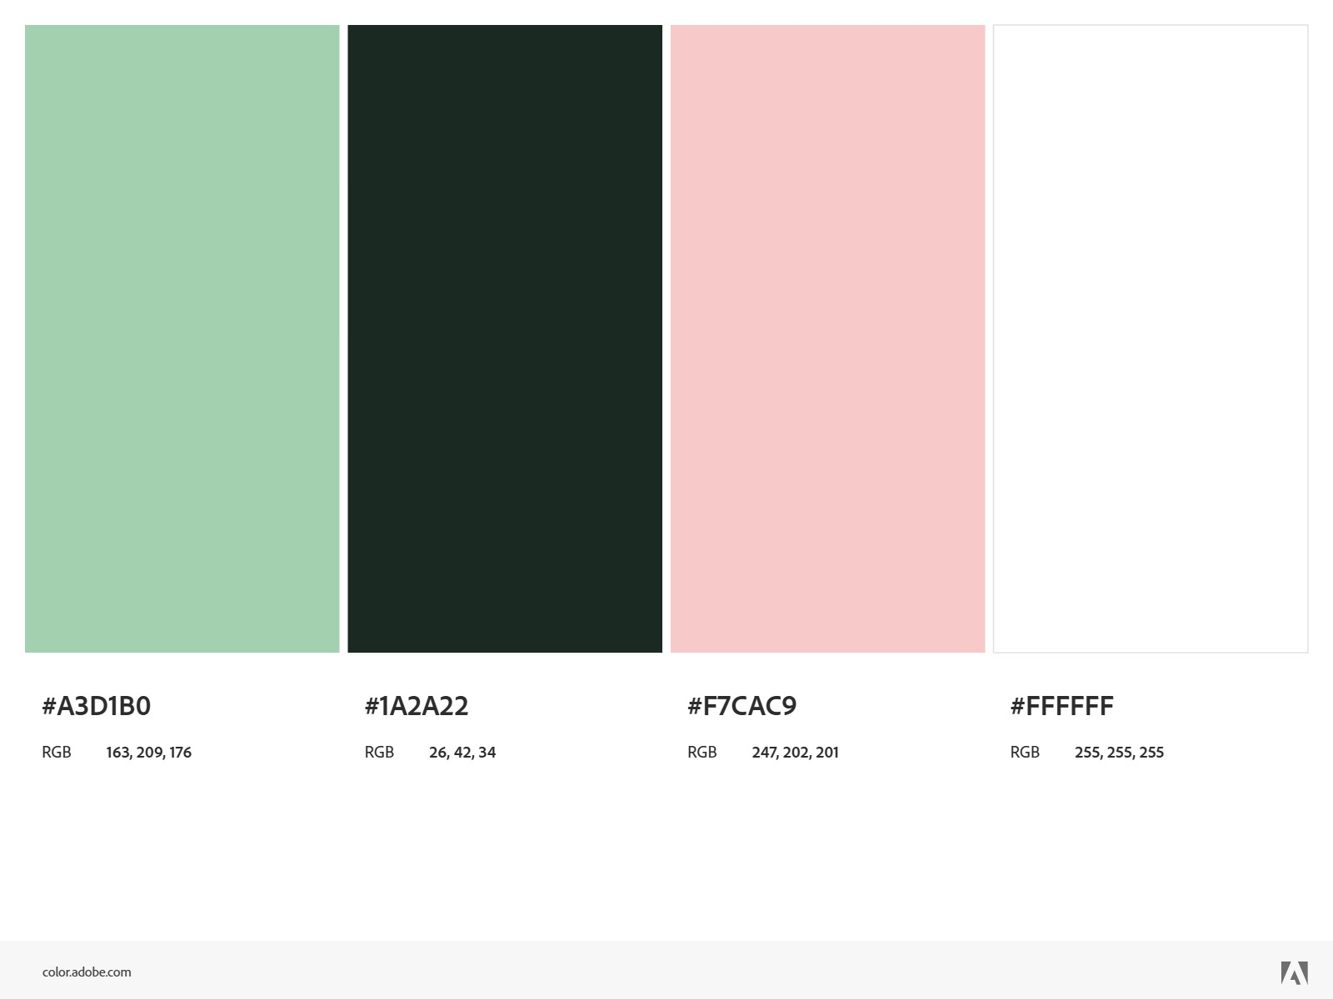
Virtual Try on Clothes
www.misterslide.net

Slide 3
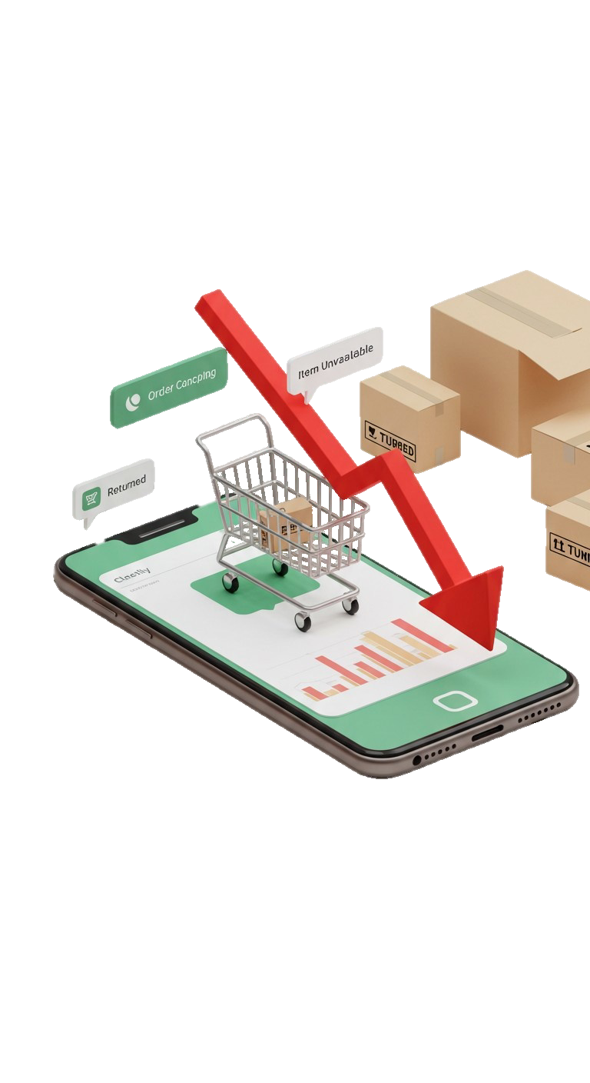
Online shopping
Virtual Try on Clothes
www.VirtualTryonClothes.com
Statistics of online shopping

Slide 4

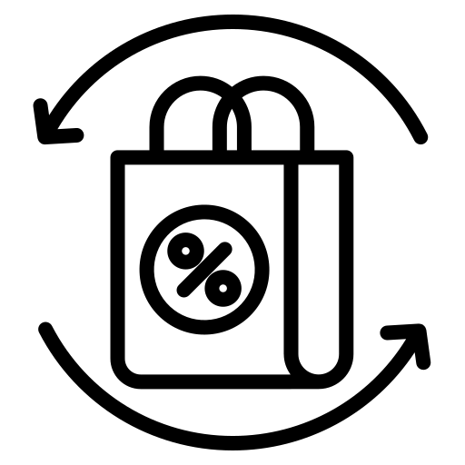
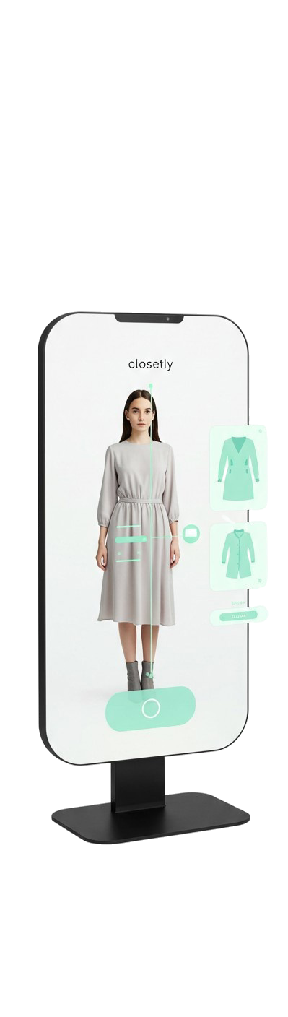
Online shopping
The most widespread means of trade
Statistics of online shopping
High Return Rates In 2024, the return rate for online purchases was approximately 16.9% [1]
Financial Impact of Returns accounted for $362.2 billion . [2]
References
https://capitaloneshopping.com/research/average-retail-return-rate,2025
https://capitaloneshopping.com/research/retail-statistics , 2025
Reference
https://www.retaildive.com/news/virtual-try-on-offers-more-sales-perfect-corp/723798/ , 2025
Virtual Try on Clothes
www.VirtualTryonClothes.com

Slide 5
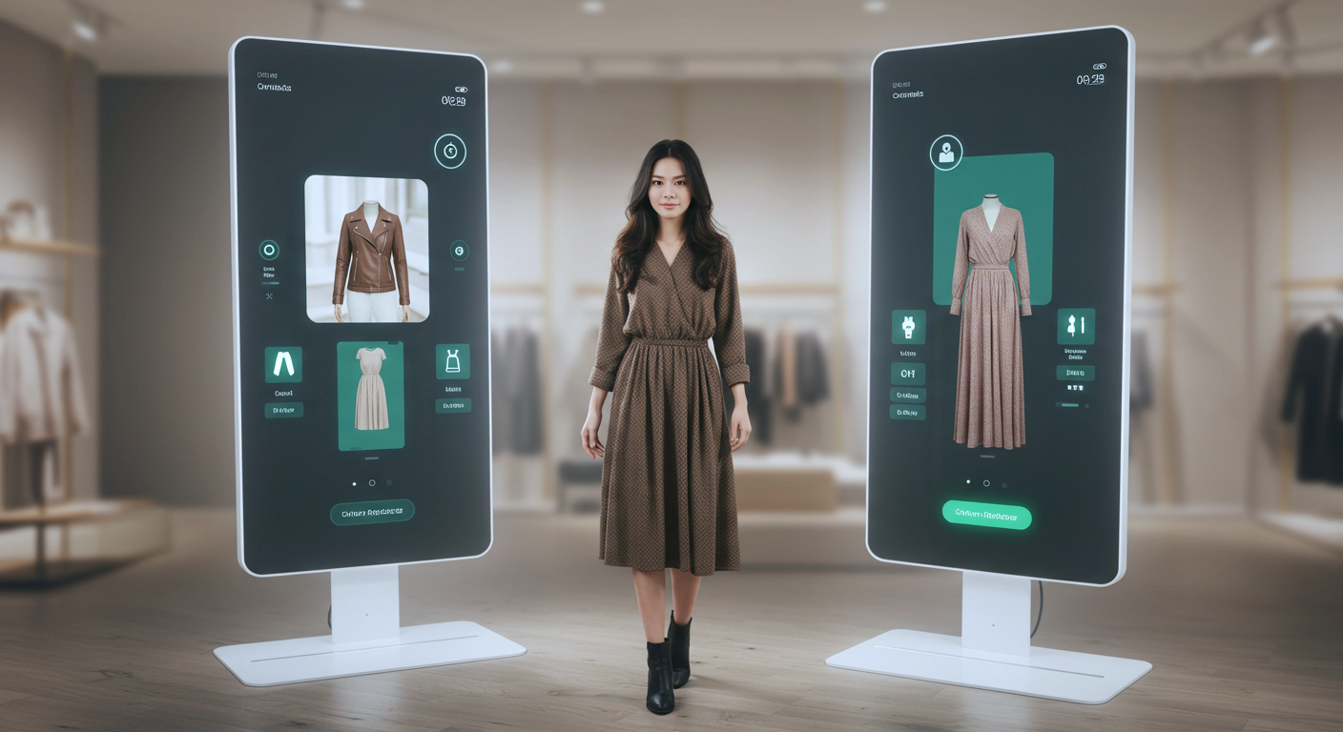
Reduction in Return Rates ENHANCED DECISION-MAKING Virtual try-on tools allow customers to visualize products on themselves, leading to more informed purchasing decisions. This has been shown to reduce return rates by up to 64%.[3]
Reference
https://www.retaildive.com/news/virtual-try-on-offers-more-sales-perfect-corp/723798/ , 2025
References
https://capitaloneshopping.com/research/average-retail-return-rate,2025
https://capitaloneshopping.com/research/retail-statistics , 2025
The most widespread means of trade
Statistics of online shopping
High Return Rates In 2024, the return rate for online purchases was approximately 16.9% [1]
Financial Impact of Returns accounted for $362.2 billion . [2]
References
https://capitaloneshopping.com/research/average-retail-return-rate,2025
https://capitaloneshopping.com/research/retail-statistics , 2025
https://www.retaildive.com/news/virtual-try-on-offers-more-sales-perfect-corp/723798/ , 2025

Slide 6
Key Challenges
Background
Reference
https://www.retaildive.com/news/virtual-try-on-offers-more-sales-perfect-corp/723798/ , 2025
Reduction in Return Rates ENHANCED DECISION-MAKING Virtual try-on tools allow customers to visualize products on themselves, leading to more informed purchasing decisions. This has been shown to reduce return rates by up to 64%.[3]

Slide 7
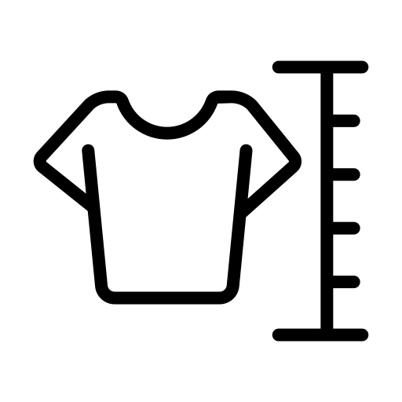


Warping Techniques:
Key Challenges
Accurate garment alignment
Preservation of clothing details (textures, logos).
Realistic rendering of human features.
Background

Slide 8
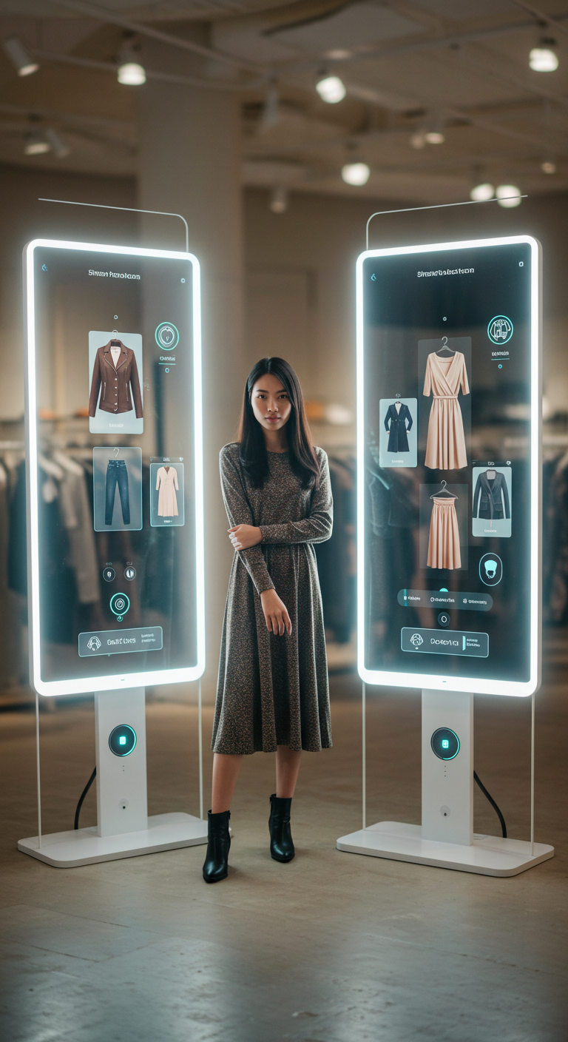
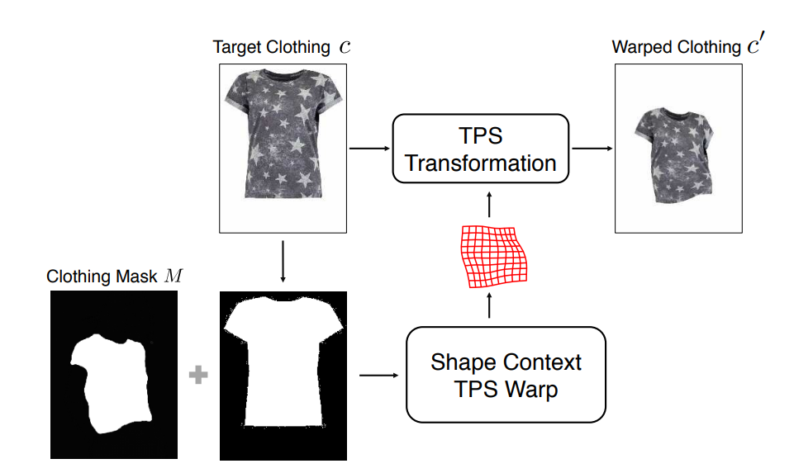
Warping Techniques:
Limitations of the models used TPS
1. Thin-Plate Spline
Used in:
Geometric Matching Module (GMM) in CP-VTON, and CP-VTON+.
Clothes Warping Module (CWM) in ACGPN.
Key Challenges
Accurate garment alignment
Preservation of clothing details (textures, logos).
Realistic rendering of human features.

Slide 9


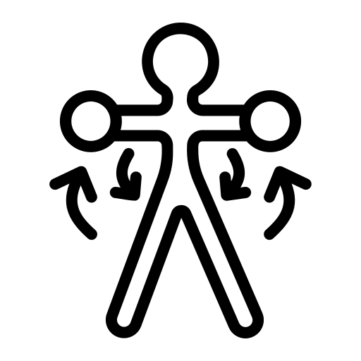


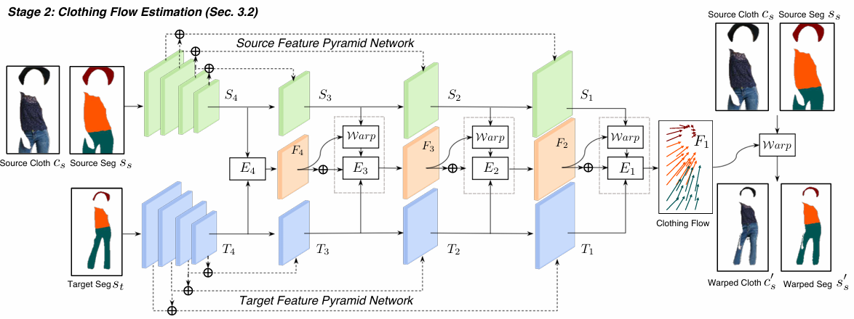
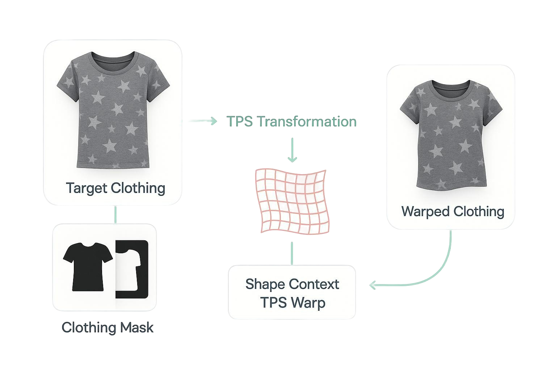
Limitations of the models used TPS
Reliance on Human Parsing.
Texture and Detail Loss in GMM stage.
Handling of Occlusions and Complex Poses.
Limited Generalization.
Local Warping Limitations.
Warping Techniques:
1. Thin-Plate Spline
Used in:
Geometric Matching Module (GMM) in CP-VTON, and CP-VTON+.
Clothes Warping Module (CWM) in ACGPN.

Slide 10
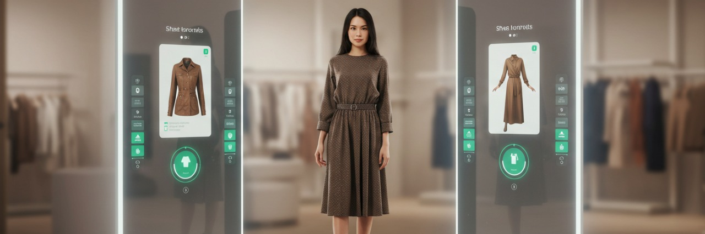
Warping Techniques:
Limitations
Limitations of the models used TPS
2. Appearance Flow Estimation in ClothFlow model
Reliance on Human Parsing.
Texture and Detail Loss in GMM stage.
Handling of Occlusions and Complex Poses.
Limited Generalization.
Local Warping Limitations.

Slide 11



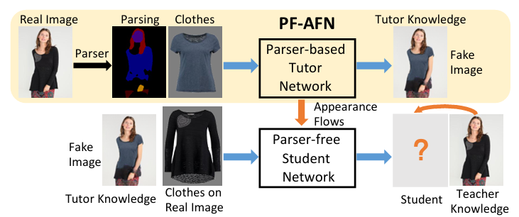
Warping Techniques:
PF-AFN (Parser-Free Approach with Appearance Flow Network)
Limitations of ClothFlow model
Still dependent on human parsing.
Local Appearance Flow Estimation.
Handling of Large Misalignments and Occlusions.
Warping Techniques:
1. Thin-Plate Spline
Used in:
Geometric Matching Module (GMM) in CP-VTON, and CP-VTON+.
2. Appearance Flow Estimation in ClothFlow model
Clothes Warping Module (CWM) in ACGPN.

Slide 12

Knowledge Distillation
PF-AFN (Parser-Free Approach with Appearance Flow Network)
Goal
“teacher-tutor-student” knowledge distillation scheme:
Distill appearance flows from a strong parser-based model (PB-AFN) into a lightweight parser-free model (PF-AFN).
Still dependent on human parsing.
Local Appearance Flow Estimation.
Handling of Large Misalignments and Occlusions.
Clothes Warping Module (CWM) in ACGPN.

Slide 13
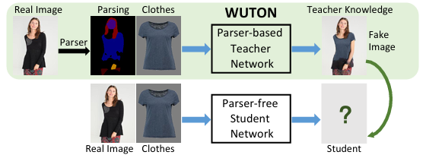


PF-AFN (Parser-Free Approach with Appearance Flow Network)
Advancements
Knowledge Distillation
Goal
However, there's a problem:
“teacher-tutor-student” knowledge distillation scheme:
The teacher model (PB-AFN) depends on human parsing and densepose estimation.
Distill appearance flows from a strong parser-based model (PB-AFN) into a lightweight parser-free model (PF-AFN).
Solution
Adjustable Knowledge Distillation.

Slide 14

Knowledge Distillation
Limitations of PF-AFN model
Advancements of PF-AFN model
Struggles with extreme poses and rich textures that stems from:
Eliminated the need for human parsing during inference by employing a parser-free framework that distills appearance flows.
Improves Upon Earlier Parser-Free Models: WUTON
Goal
However, there's a problem:
Distill appearance flows from a strong parser-based model (PB-AFN) into a lightweight parser-free model (PF-AFN).
The teacher model (PB-AFN) depends on human parsing and densepose estimation.
Solution
Adjustable Knowledge Distillation.

Slide 15
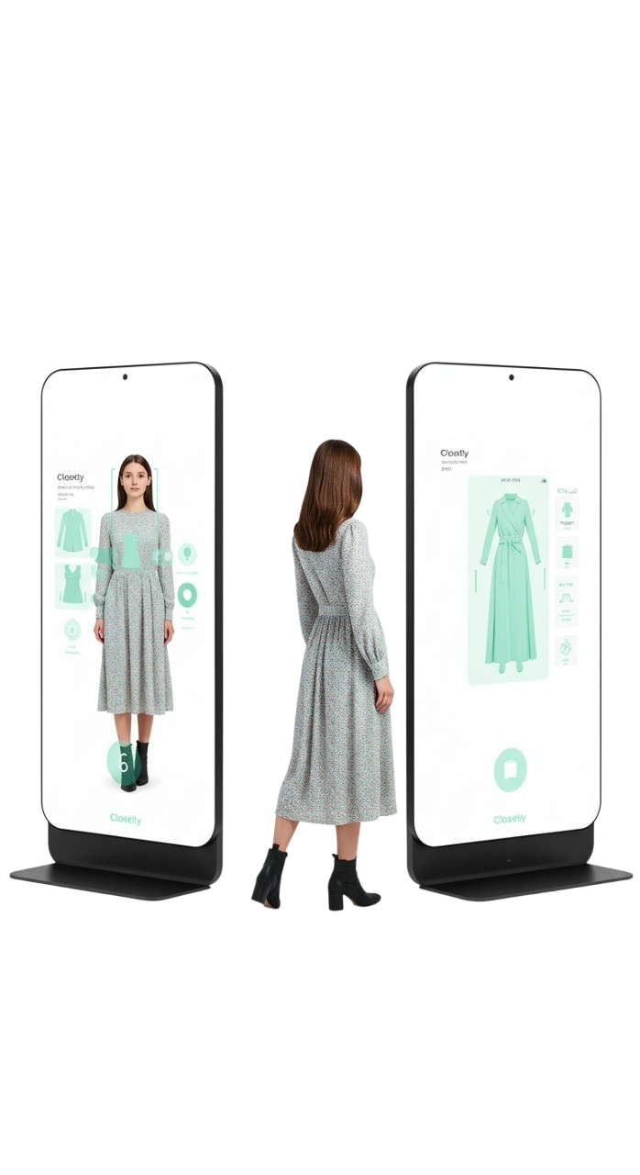
Our model Style based global appearance flow estimation
Used model Style based global appearance flow estimation
Advancements
Limitations of PF-AFN model
Struggles with extreme poses and rich textures that stems from:
The local nature of appearance flow estimation.
The absence of global context modeling.
Eliminated the need for human parsing during inference by employing a parser-free framework that distills appearance flows.
Improves Upon Earlier Parser-Free Models: WUTON
References
https://capitaloneshopping.com/research/average-retail-return-rate,2025
https://capitaloneshopping.com/research/retail-statistics , 2025
https://www.retaildive.com/news/virtual-try-on-offers-more-sales-perfect-corp/723798/ , 2025

Slide 16
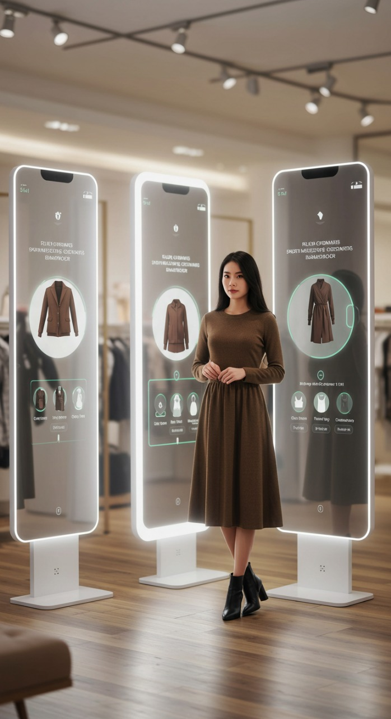
Used model Style based global appearance flow estimation
Limitations of PF-AFN model
Unlike previous models that rely only on local refinement for garment alignment, our approach combines global warping with local refinement — enabling more accurate alignment even under large pose variations and occlusions.
Struggles with extreme poses and rich textures that stems from:
The local nature of appearance flow estimation.
The absence of global context modeling.
References
https://capitaloneshopping.com/research/average-retail-return-rate,2025
https://capitaloneshopping.com/research/retail-statistics , 2025
https://www.retaildive.com/news/virtual-try-on-offers-more-sales-perfect-corp/723798/ , 2025

Slide 17
Used model Style based global appearance flow estimation
Our model Style based global appearance flow estimation
how do Global warping and local refinement work?
Style GAN and appearance flow estimation
Global Style Vector (s)
Unlike previous models that rely only on local refinement for garment alignment, our approach combines global warping with local refinement — enabling more accurate alignment even under large pose variations and occlusions.
Our model leverages StyleGAN-inspired modulation by introducing a global style vector that guides the warping process. This vector captures the overall pose and structure of the person, allowing the network to align garments globally before refining them locally. This global-to-local strategy improves accuracy in complex cases where traditional local refinement alone would fail.
It is extracted from the deepest features of the person and garment encoders. Both features are passed through fully connected layers, then concatenated. It is used to modulate convolutional weights in the warping blocks. It captures pose and structure and guides the network to perform global garment alignment.

Slide 18
The use of parser free model
how do Global warping and local refinement work?
Style GAN and appearance flow estimation
Global Style Vector (s)
Local Refinement
Our model leverages StyleGAN-inspired modulation by introducing a global style vector that guides the warping process. This vector captures the overall pose and structure of the person, allowing the network to align garments globally before refining them locally. This global-to-local strategy improves accuracy in complex cases where traditional local refinement alone would fail.
It is extracted from the deepest features of the person and garment encoders. Both features are passed through fully connected layers, then concatenated. It is used to modulate convolutional weights in the warping blocks. It captures pose and structure and guides the network to perform global garment alignment.
It takes the warped garment features from coarse flow field and the person features at the same level. It concatenates them and passes through a convolutional block, and outputs a refined flow field.
Final appearance flow:
fi​=fci​+fri​

Slide 19
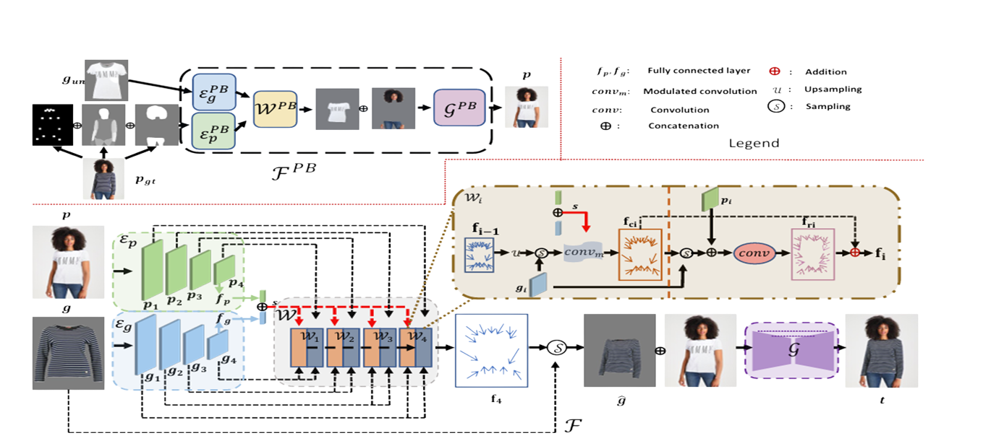
Steps of the model
how do Global warping and local refinement work?
The use of parser free model
Global Style Vector (s)
It is extracted from the deepest features of the person and garment encoders. Both features are passed through fully connected layers, then concatenated. It is used to modulate convolutional weights in the warping blocks. It captures pose and structure and guides the network to perform global garment alignment.
Our model uses a teacher-student training strategy, where the teacher leverages parsing maps and pose annotations to guide learning. The student, however, learns to perform the same task without any semantic inputs. During inference, only the student is used, making the model completely parser-free. This provides a major advantage by reducing complexity, speeding up inference, and avoiding dependency on external human parsers.
Local Refinement
It takes the warped garment features from coarse flow field and the person features at the same level. It concatenates them and passes through a convolutional block, and outputs a refined flow field.
Final appearance flow:
fi​=fci​+fri​

Slide 20
Loss functions
Steps of the model
Loss functions
The use of parser free model
Extract features from person and garment images using encoders.
Generate global style vector from the deepest features.
Our model uses a teacher-student training strategy, where the teacher leverages parsing maps and pose annotations to guide learning. The student, however, learns to perform the same task without any semantic inputs. During inference, only the student is used, making the model completely parser-free. This provides a major advantage by reducing complexity, speeding up inference, and avoiding dependency on external human parsers.
Estimate coarse appearance flow using style-modulated warping blocks.
Refine the flow locally using person-garment features.
Warp the garment using the final flow field.
Concatenate warped garment with person image.
Generate final try-on image using a U-Net generator.

Slide 21
Steps of the model
Loss functions
Limitations
While our model achieves strong performance, it comes with increased complexity. The architecture includes multiple encoders, warping blocks, refinement stages, and a generator, which leads to higher memory usage and longer training time. This complexity may limit deployment or use without further optimization.
Garment Loss Lg:
Distillation Loss LD:
Perceptual Loss Lp:
Flow Smoothness LR:
It ensures the generated image looks visually similar to the real one. It compares deep features of the generated and real images using a pretrained network.
It preserves garment texture and shape accuracy. It compares garment regions in the generated image and ground truth using a binary mask.
It encourages smooth, natural warping. It penalizes abrupt changes in the flow field to avoid sharp distortions.
It teaches the student model to behave like the teacher. It minimizes the difference between student and teacher feature maps at multiple levels.
∥ϕ(t)−ϕ(t∗)∥1​
∥M⊙t−M⊙t∗∥1​
∥∇f∥1​
∑i​∥EiT​−EiS​∥1​
Extract features from person and garment images using encoders.
Generate global style vector from the deepest features.
Estimate coarse appearance flow using style-modulated warping blocks.
Refine the flow locally using person-garment features.
Warp the garment using the final flow field.
Concatenate warped garment with person image.
Generate final try-on image using a U-Net generator.

Slide 22

Loss functions
Limitations
Component
While our model achieves strong performance, it comes with increased complexity. The architecture includes multiple encoders, warping blocks, refinement stages, and a generator, which leads to higher memory usage and longer training time. This complexity may limit deployment or use without further optimization.
Description
Used By (Module)
Perceptual Loss Lp:
Garment Loss Lg:
Flow Smoothness LR:
Distillation Loss LD:
It ensures the generated image looks visually similar to the real one. It compares deep features of the generated and real images using a pretrained network.
It preserves garment texture and shape accuracy. It compares garment regions in the generated image and ground truth using a binary mask.
It encourages smooth, natural warping. It penalizes abrupt changes in the flow field to avoid sharp distortions.
It teaches the student model to behave like the teacher. It minimizes the difference between student and teacher feature maps at multiple levels.
∥ϕ(t)−ϕ(t∗)∥1​
∥M⊙t−M⊙t∗∥1​
∥∇f∥1​
∑i​∥EiT​−EiS​∥1​

Slide 23

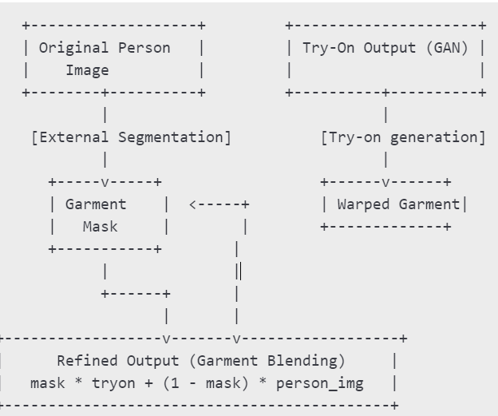

3.Mask-Based Refinement
Use a body mask to blend the warped garment more precisely into the person image.
Dataset Limitation | How Your Test-Time Modifications Help Address It
Low diversity | Test-Time Augmentation (TTA) simulates different viewing conditions (flips, brightness), making the model more general to left- and right-facing poses or asymmetric body clothing alignment.
Synthetic structure | Edge-aware Filtering & Segmentation Refinement smooth unnatural garment edges and reduce visual artifacts — compensating for the clean studio-like setting of VITON.
Small size | TTA acts like pseudo-ensemble learning, making each test image act like multiple pseudo-samples (via flipping), giving you “more data per sample” without needing a bigger dataset.
Outdated resolution | Sharpening Filter and Gamma Correction enhance fine details, making low-res outputs more crisp and visually appealing, closing the gap with higher-res datasets.
Static poses only | Augmented VITON test set (zoom, shift) simulates body misalignment and perspective variation, which imitates real-world motion or misplacement in the absence of dynamic data.
Modifications
1.Test-Time Augmentation (TTA):Apply transformations (Brightness Adjustment, horizontal flip) to the input, pass them through the model, and average the outputs averaging them pixel-wise way .
It reduces noise and artifacts by leveraging ensemble-like behavior.
Approach
Use pre-existing human segmentation model ( MODNet).
Blend only garment regions from the output onto the original person image.
2.Post-Processing: Guided Filtering / Smoothing: Smooth the output try-on image and blend the warped garment better with the person image using edge-aware filters.
Improves garment-to-skin blending quality.
Preserves face, background, and non-garment areas untouched
Prevents over-smoothing or warping artifacts outside clothing

Slide 24
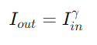
4.Exposure Correction (Gamma Adjustment)
Modifications
3.Mask-Based Refinement
Use a body mask to blend the warped garment more precisely into the person image.
Dynamically correct image brightness and contrast post-generation, especially for dark or flat images.
Approach
Use pre-existing human segmentation model ( MODNet).
Blend only garment regions from the output onto the original person image.
Preserves face, background, and non-garment areas untouched
Prevents over-smoothing or warping artifacts outside clothing
1.Test-Time Augmentation (TTA):Apply transformations (Brightness Adjustment, horizontal flip) to the input, pass them through the model, and average the outputs averaging them pixel-wise way .
It reduces noise and artifacts by leveraging ensemble-like behavior.
2.Post-Processing: Guided Filtering / Smoothing: Smooth the output try-on image and blend the warped garment better with the person image using edge-aware filters.
Improves garment-to-skin blending quality.
5.Color Correction (Histogram Matching)
Make the warped garment color look more natural by aligning its distribution with the original garment.
Compare color histograms between the warped garment and the original cloth.
Match the color distribution from the original garment.

Slide 25
3.Mask-Based Refinement
Use a body mask to blend the warped garment more precisely into the person image.
6. Add Web Interface Streamlit GUI (Closetly)
4.Exposure Correction (Gamma Adjustment)
Dynamically correct image brightness and contrast post-generation, especially for dark or flat images.
5.Color Correction (Histogram Matching)
Make the warped garment color look more natural by aligning its distribution with the original garment.
Compare color histograms between the warped garment and the original cloth.
Match the color distribution from the original garment.
Approach
Use pre-existing human segmentation model ( MODNet).
Blend only garment regions from the output onto the original person image.
Preserves face, background, and non-garment areas untouched
Prevents over-smoothing or warping artifacts outside clothing

Slide 26
4.Exposure Correction (Gamma Adjustment)
6. Add Web Interface Streamlit GUI (Closetly)
Description
How do we calculate
Dynamically correct image brightness and contrast post-generation, especially for dark or flat images.
You built a user-facing GUI using Streamlit, titled Closetly, allowing real-time try-on previews by uploading person and clothing image.
FID(FrechetInceptionDistance)compares two sets of images ( ground truth vs. generated ) .
5.Color Correction (Histogram Matching)
Make the warped garment color look more natural by aligning its distribution with the original garment.
Mean and Covariance of real image features.
Compare color histograms between the warped garment and the original cloth.
Match the color distribution from the original garment.
Mean and Covariance of generated image features.

Slide 27
SSIM measures how similar two images are in terms of
6. Add Web Interface Streamlit GUI (Closetly)
Description
How do we calculate
Requirement | Description
Generated Images | Try-on outputs from your model (e.g., our_t_results/)
Ground Truth Images | Corresponding real person wearing the target garment
Matching Names | Filenames must match: 00001.jpg in both folders
FID Tool (Python) | use pytorch-fid
You built a user-facing GUI using Streamlit, titled Closetly, allowing real-time try-on previews by uploading person and clothing image.
FID compares two sets of images (e.g., ground truth vs. generated) using features .
Mean and Covariance of real image features.
Mean and Covariance of generated image features.

Slide 28



SSIM(Structural Similarity Index Measure) measures how similar two images are in terms of
Unlike MSE or L1 treat all pixels equally.They don't account for structure, textures, or perceptual importance.
Structural content
Contrast
Luminance (brightness)
Requirement | Description
Generated Images | Try-on outputs from your model (e.g., our_t_results/)
Ground Truth Images | Corresponding real person wearing the target garment
Matching Names | Filenames must match: 00001.jpg in both folders
FID Tool (Python) | use pytorch-fid

Slide 29
SSIM measures how similar two images are in terms of
Requirement | Description
Generated Image | Your try-on output (p_tryon)
Ground Truth | Real image of person wearing the garment (p_gt)
Matching size | Images must be the same dimensions
Value range | Both images should be in [0, 1] (float) .
Using pytorch-msssim
Unlike MSE or L1, SSIM better reflects human perception of quality.
Structural content
Contrast
Luminance (brightness)

Slide 30
Knowledge Distillation
This extension will be the interface that will appear when users want to virtually try on their clothes. The platform we used for building our GUI is Streamlit.
GUI
Metric | Before Mods | Expected After Mods | Why?
SSIM | 0.91 | 0.920 | Improved garment-person alignment and edge blending
FID | 8.89 | 8.5 (slight drop) | Warped garments resemble real clothing more closely
User Perception | — | Significantly Better | Streamlit GUI improves visual inspection and interactivity.
UX Usability | Not Available | Excellent | Web interface allows non-experts to use the model instantly.
Requirement | Description
Generated Image | Your try-on output (p_tryon)
Ground Truth | Real image of person wearing the garment (p_gt)
Matching size | Images must be the same dimensions
Value range | Both images should be in [0, 1] (float) or [0, 255]
Why Streamlit ?
Streamlit is a Python-native framework that requires no web development experience.
One script (app.py) runs the full GUI. It also refreshes to test changes quickly and is compatible with machine and deep learning projects.
Streamlit launches on localhost and Google Colab notebooks run on temporary cloud servers.
As a compromise, we used ngrok
ngrok is creates a public web address that forwards to your local Streamlit app running inside Colab that when clicked on opens directly in browser.
Using pytorch-msssim

Slide 31
2. Why was VITON chosen?
Dataset used is “Virtual Try-On Network” dataset:
Limitations
Component
image
cloth
edge
label.
pose
While our model achieves strong performance, it comes with increased complexity. The architecture includes multiple encoders, warping blocks, refinement stages, and a generator, which leads to higher memory usage and longer training time. This complexity may limit deployment or use without further optimization.
Person image wearing the garment(p_gt)
In-shop product image(input cloth)
Binary mask of the clothing region (garment-only area)
Segmentation map of body parts
JSON pose maps
Description
Used By (Module)
p_gt, SSIM groundtruth
Input for garment warping
Used in edge mask blending
Used in parser-based mode
Optional, not always used
Warping Techniques:
1. Thin-Plate Spline
Used in:
Geometric Matching Module (GMM) in CP-VTON, and CP-VTON+.
Clothes Warping Module (CWM) in ACGPN.

Slide 32
Dataset used is “Virtual Try-On Network” dataset:
2. Why was VITON chosen?
Reason | Explanation
Benchmark dataset | Used in CP-VTON, ACGPN, ClothFlow. ensuring comparability
Aligned poses | Clothing and person poses are mostly aligned, simplifying flow estimation
Ground truth available | Has the real output image (p_gt) of person wearing the garment
Supports segmentation flow | Has parsing maps and masks for advanced techniques
Open access | Can be requested/downloaded without commercial restrictions
Component
image
cloth
edge
label.
pose
Person image wearing the garment(p_gt)
In-shop product image(input cloth)
Binary mask of the clothing region (garment-only area)
Segmentation map of body parts
JSON pose maps
Description
Used By (Module)
p_gt, SSIM groundtruth
Input for garment warping
Used in edge mask blending
Used in parser-based mode
Optional, not always used

Slide 33
Dataset Limitation | How our Modifications Help Address It
Low diversity | Test-Time Augmentation (TTA) simulates different viewing conditions (flips, brightness), making the model more general to left- and right-facing poses or asymmetric body clothing alignment.
Synthetic structure | Edge-aware Filtering & Segmentation Refinement smooth unnatural garment edges and reduce visual artifacts — compensating for the clean studio-like setting of VITON.
Small size | TTA acts like pseudo-ensemble learning, making each test image act like multiple pseudo-samples (via flipping), giving you “more data per sample” without needing a bigger dataset.
Outdated resolution | Gamma Correction enhance fine details, making low-res outputs more crisp and visually appealing, closing the gap with higher-res datasets.
Modifications
Advantage | Explanation
Standardized evaluation | Enables SSIM, FID on known test set
Parsing/mask availability | Enables parser-based methods
Open access (relatively) | Can be requested/downloaded without commercial restrictions
Clean pairs | Mostly clean backgrounds, well-aligned inputs

Slide 34

What happens behind the scenes?
1) Preprocessing:
GUI
This extension will be the interface that will appear when users want to virtually try on their clothes. The platform we used for building our GUI is Streamlit.
Why Streamlit ?
Streamlit is a Python-native framework that requires no web development experience.
One script (app.py) runs the full GUI. It also refreshes to test changes quickly and is compatible with machine and deep learning projects.
Streamlit launches on localhost and Google Colab notebooks run on temporary cloud servers.
As a compromise, we used ngrok
ngrok is creates a public web address that forwards to your local Streamlit app running inside Colab that when clicked on opens directly in browser.
Metric | Before Mods | Expected After Mods | Why?
SSIM | 0.91 | 0.920 | Improved garment-person alignment and edge blending
FID | 8.89 | 8.5 (slight drop) | Warped garments resemble real clothing more closely
User Perception | — | Significantly Better | Streamlit GUI improves visual inspection and interactivity
UX Usability | Not Available | Excellent | Web interface allows non-experts to use the model instantly

Slide 35
GUI
What happens behind the scenes?
Knowledge Distillation
1) Preprocessing:
1.2 On the Garment Image:
We have to present the garment clearly, centered, and without irrelevant background.
The model expects the garment alone (isolated), not on a mannequin or model.
So, we Removed Background of garment images.
Aligned the Garment by Centering the clothing vertically, cropping the extra whitespace on sides and standardizing clothing orientation (neck on top, hem on bottom).
Applied light color balancing: Remove strong shadows or reflections.
And same as for person images, we applied normalization and resizing.
1.1 On the person Image:
Many photos include extra background. If the person is too small or off-center, it affects garment alignment, so the solution for this is Image Cropping using human segmentation.
To avoid background clutter that can confuse the warping/generation model. We applied Background Removal . This makes the model focus on person, not the background
Done By: Applying the person mask and replace background with white or transparent.
Color filtering: contrast boosting for low-light images while avoiding heavy filters because the model expects natural skin and fabric tones.
Normalization: Convert the image to a tensor [C, H, W] with values in [0, 1].
Most necessary is resizing to fixed input size: VTON models typically expect256x192 (HxW) image.
This extension will be the interface that will appear when users want to virtually try on their clothes. The platform we used for building our GUI is Streamlit.
Why Streamlit ?
Streamlit is a Python-native framework that requires no web development experience.
One script (app.py) runs the full GUI. It also refreshes to test changes quickly and is compatible with machine and deep learning projects.
Streamlit launches on localhost and Google Colab notebooks run on temporary cloud servers.
As a compromise, we used ngrok
ngrok is creates a public web address that forwards to your local Streamlit app running inside Colab that when clicked on opens directly in browser.

Slide 36
Loss functions
What happens behind the scenes?
1) Preprocessing:
1.2 On the Garment Image:
We have to present the garment clearly, centered, and without irrelevant background.
The model expects the garment alone (isolated), not on a mannequin or model.
So, we Removed Background of garment images.
Aligned the Garment by Centering the clothing vertically, cropping the extra whitespace on sides and standardizing clothing orientation (neck on top, hem on bottom).
Applied light color balancing: Remove strong shadows or reflections.
And same as for person images, we applied normalization and resizing.
1.1 On the person Image:
Many photos include extra background. If the person is too small or off-center, it affects garment alignment, so the solution for this is Image Cropping using human segmentation.
To avoid background clutter that can confuse the warping/generation model. We applied Background Removal . This makes the model focus on person, not the background
Done By: Applying the person mask and replace background with white or transparent.
Color filtering: contrast boosting for low-light images while avoiding heavy filters because the model expects natural skin and fabric tones.
Normalization: Convert the image to a tensor [C, H, W] with values in [0, 1].
Most necessary is resizing to fixed input size: VTON models typically expect256x192 (HxW) image.

Slide 37
Loss functions
What happens behind the scenes?
1) Preprocessing:
1.2 On the Garment Image:
We have to present the garment clearly, centered, and without irrelevant background.
The model expects the garment alone (isolated), not on a mannequin or model.
So, we Removed Background of garment images.
Aligned the Garment by Centering the clothing vertically, cropping the extra whitespace on sides and standardizing clothing orientation (neck on top, hem on bottom).
Applied light color balancing: Remove strong shadows or reflections.
And same as for person images, we applied normalization and resizing.
1.2 On the Garment Image:
We have to present the garment clearly, centered, and without irrelevant background.
The model expects the garment alone (isolated), not on a mannequin or model.
So, we Removed Background of garment images.
Aligned the Garment by Centering the clothing vertically, cropping the extra whitespace on sides and standardizing clothing orientation (neck on top, hem on bottom).
Applied light color balancing: Remove strong shadows or reflections.
And same as for person images, we applied normalization and resizing.
2) Warping Stage: by AFWM.
3) Composition Stage: by ResUnetGenerator.
4) Post Processing:
4) Post Processing:
As we mentioned earlier, afwm acts as a digital tailor. It takes the input preprocessed image and produces an appearance flow map used to warp the garment image.
As we also mentioned earlier, ResUnetGenerator acts as an editor to AFWM. It takes the warped garment + person image and produces the Final try-on image (realistic and natural-looking)

Slide 38
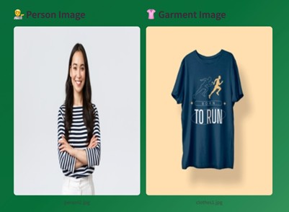
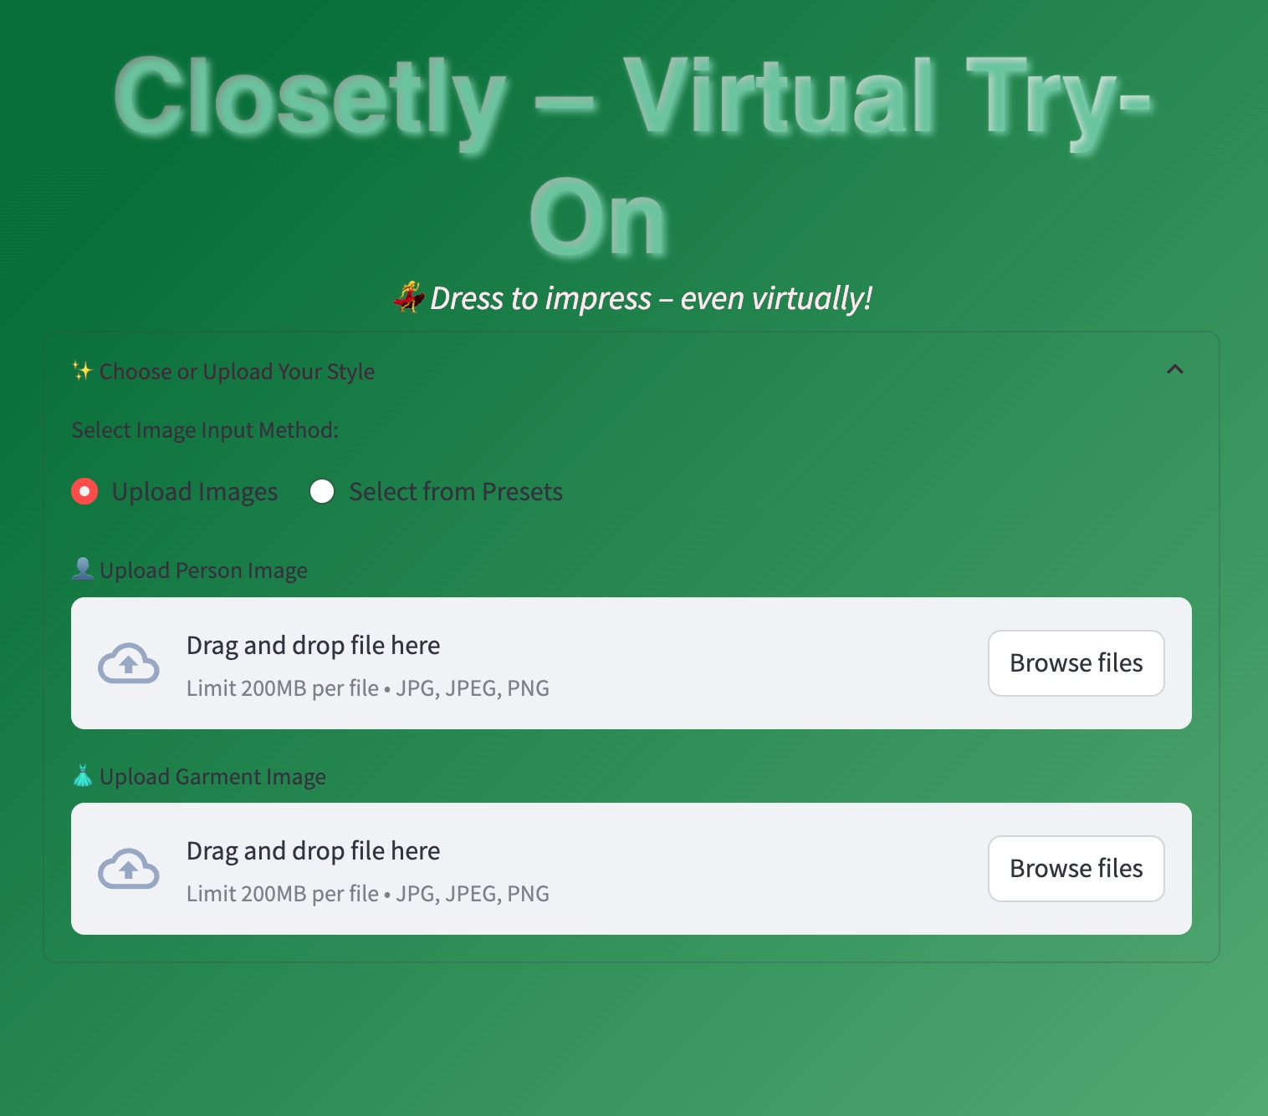
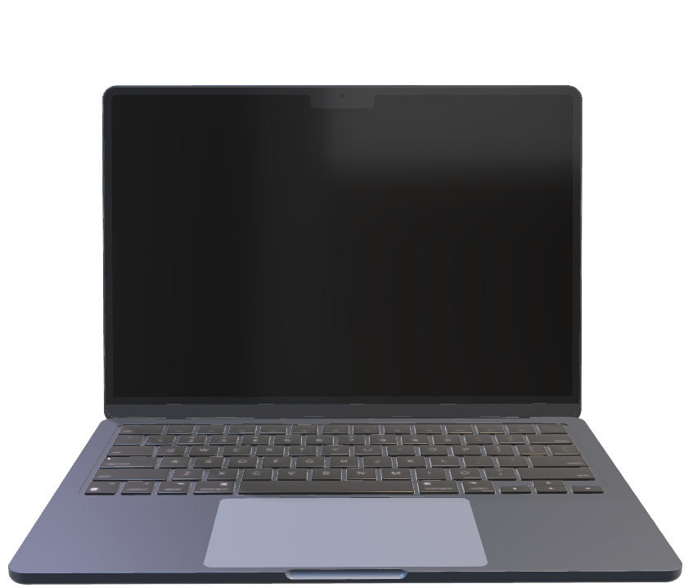
Loss functions
Future work:
What happens behind the scenes?
API Integration for E-Commerce Platforms: We want to enable fashion websites to easily integrate the virtual try-on system through an API or plugin.
Future Work: Develop a GraphQL endpoint for garment try-on / Add "Try It On" buttons next to product listings.
Complete Outfit Generation (Outfit Recommendation Engine): Recommend full outfit sets -e.g., top + pants + shoes + accessories.
1.2 On the Garment Image:
We have to present the garment clearly, centered, and without irrelevant background.
The model expects the garment alone (isolated), not on a mannequin or model.
So, we Removed Background of garment images.
Aligned the Garment by Centering the clothing vertically, cropping the extra whitespace on sides and standardizing clothing orientation (neck on top, hem on bottom).
Applied light color balancing: Remove strong shadows or reflections.
And same as for person images, we applied normalization and resizing.
4) Post Processing:
We did this essentially because: Images may look completely black or white, colors might be inverted or washed out and GUI may crash if passed unsupported formats.
Denormalize the pixel values.
Remove Batch Dimension: The model outputs tensor shape [1, 3, H, W]. so we remove the 1 tensor so the image would be displayable. To process the image, we "squeeze" which outputs shape [3, H, W].
Convert to Image Format (PIL)
2) Warping Stage: by AFWM.
3) Composition Stage: by ResUnetGenerator.
As we mentioned earlier, afwm acts as a digital tailor. It takes the input preprocessed image and produces an appearance flow map used to warp the garment image.
As we also mentioned earlier, ResUnetGenerator acts as an editor to AFWM. It takes the warped garment + person image and produces the Final try-on image (realistic and natural-looking)

Slide 39
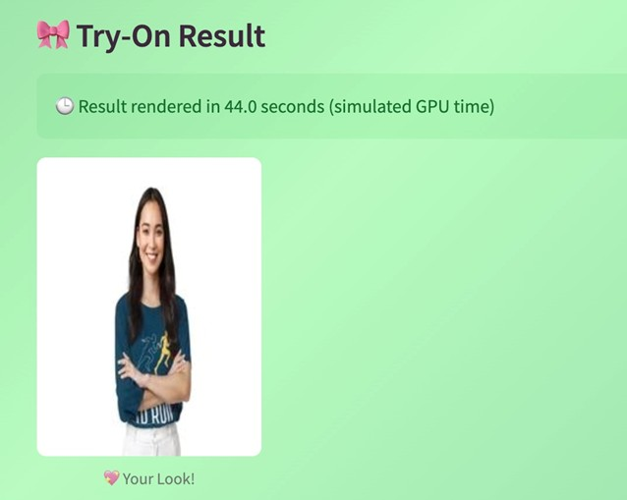
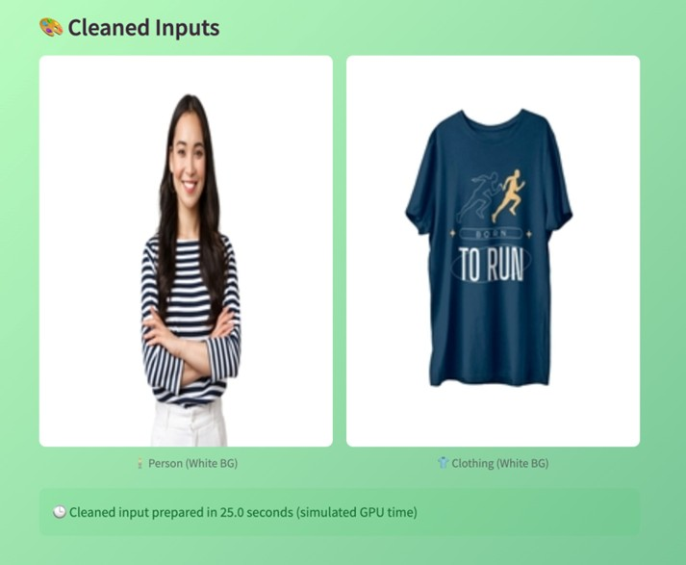

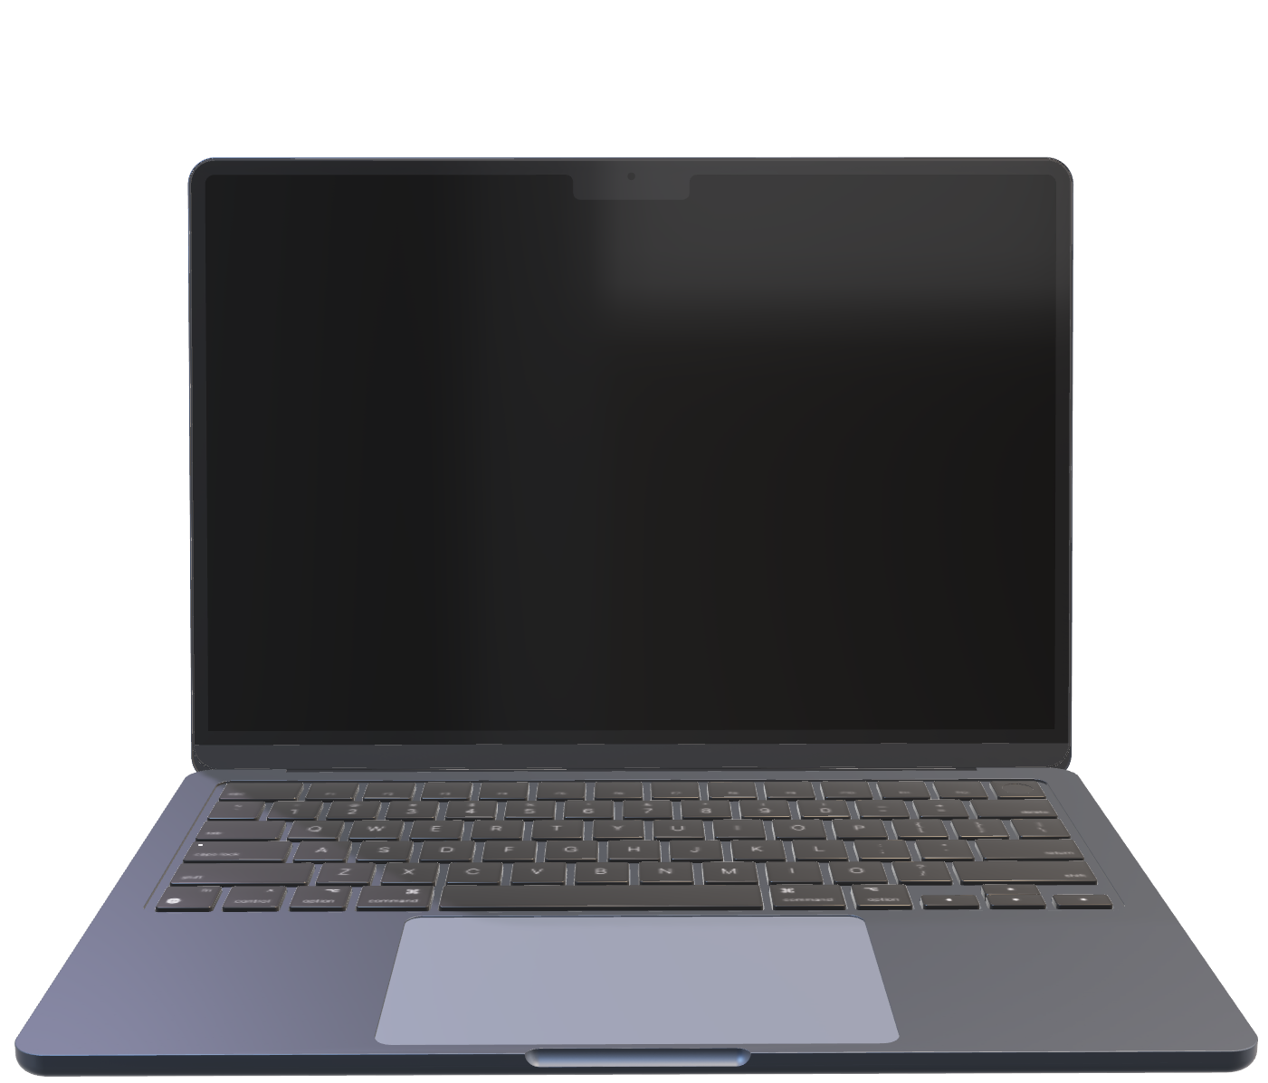
Loss functions
What happens behind the scenes?
Future work:
API Integration for E-Commerce Platforms: We want to enable fashion websites to easily integrate the virtual try-on system through an API or plugin.
Future Work: Develop a GraphQL endpoint for garment try-on / Add "Try It On" buttons next to product listings.
Complete Outfit Generation (Outfit Recommendation Engine): Recommend full outfit sets -e.g., top + pants + shoes + accessories.
4) Post Processing:
We did this essentially because: Images may look completely black or white, colors might be inverted or washed out and GUI may crash if passed unsupported formats.
Denormalize the pixel values.
Remove Batch Dimension: The model outputs tensor shape [1, 3, H, W]. so we remove the 1 tensor so the image would be displayable. To process the image, we "squeeze" which outputs shape [3, H, W].
Convert to Image Format (PIL)
2) Warping Stage: by AFWM.
3) Composition Stage: by ResUnetGenerator.
As we mentioned earlier, afwm acts as a digital tailor. It takes the input preprocessed image and produces an appearance flow map used to warp the garment image.
As we also mentioned earlier, ResUnetGenerator acts as an editor to AFWM. It takes the warped garment + person image and produces the Final try-on image (realistic and natural-looking)

Slide 40
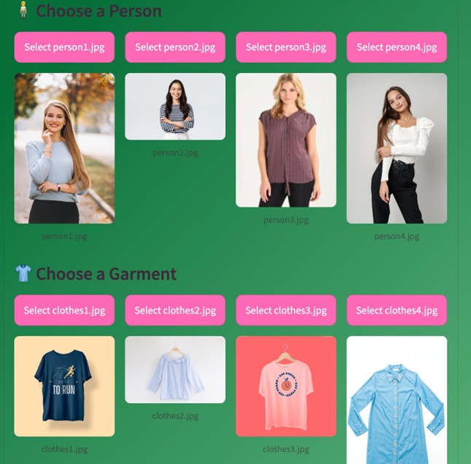
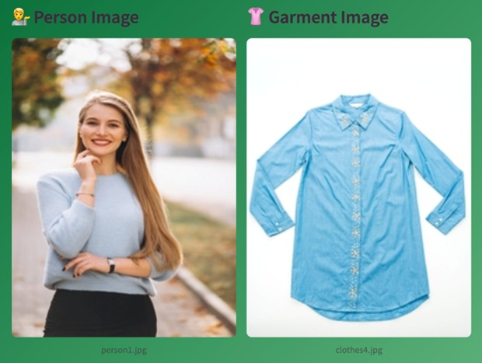
What happens behind the scenes?
Future work:
API Integration for E-Commerce Platforms: We want to enable fashion websites to easily integrate the virtual try-on system through an API or plugin.
Future Work: Develop a GraphQL endpoint for garment try-on / Add "Try It On" buttons next to product listings.
Complete Outfit Generation (Outfit Recommendation Engine): Recommend full outfit sets -e.g., top + pants + shoes + accessories.
4) Post Processing:
We did this essentially because: Images may look completely black or white, colors might be inverted or washed out and GUI may crash if passed unsupported formats.
Denormalize the pixel values.
2) Warping Stage: by AFWM.
3) Composition Stage: by ResUnetGenerator.
As we mentioned earlier, afwm acts as a digital tailor. It takes the input preprocessed image and produces an appearance flow map used to warp the garment image.
As we also mentioned earlier, ResUnetGenerator acts as an editor to AFWM. It takes the warped garment + person image and produces the Final try-on image (realistic and natural-looking)

Slide 41
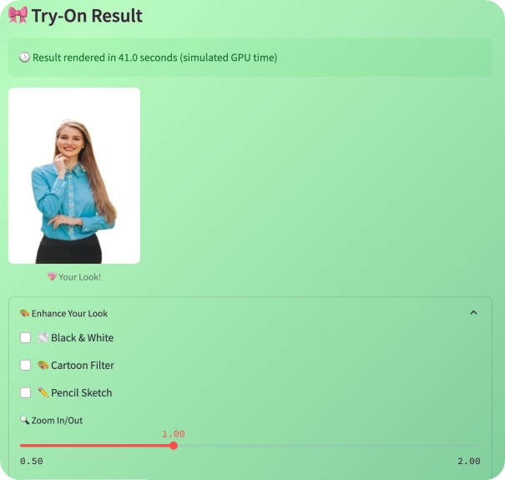
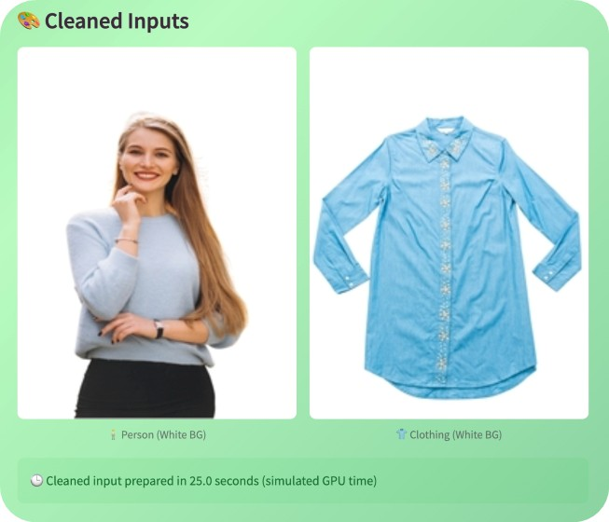
What happens behind the scenes?
Future work:
API Integration for E-Commerce Platforms: We want to enable fashion websites to easily integrate the virtual try-on system through an API or plugin.
Future Work: Develop a GraphQL endpoint for garment try-on / Add "Try It On" buttons next to product listings.
Complete Outfit Generation (Outfit Recommendation Engine): Recommend full outfit sets -e.g., top + pants + shoes + accessories.
4) Post Processing:
We did this essentially because: Images may look completely black or white, colors might be inverted or washed out and GUI may crash if passed unsupported formats.
Denormalize the pixel values.
2) Warping Stage: by AFWM.
3) Composition Stage: by ResUnetGenerator.
As we mentioned earlier, afwm acts as a digital tailor. It takes the input preprocessed image and produces an appearance flow map used to warp the garment image.
As we also mentioned earlier, ResUnetGenerator acts as an editor to AFWM. It takes the warped garment + person image and produces the Final try-on image (realistic and natural-looking)

Slide 42
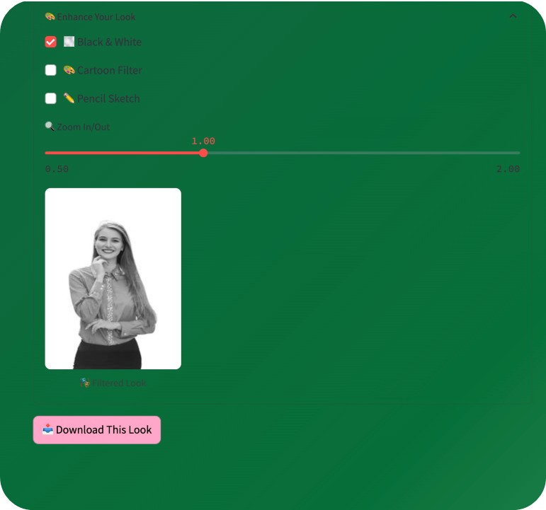

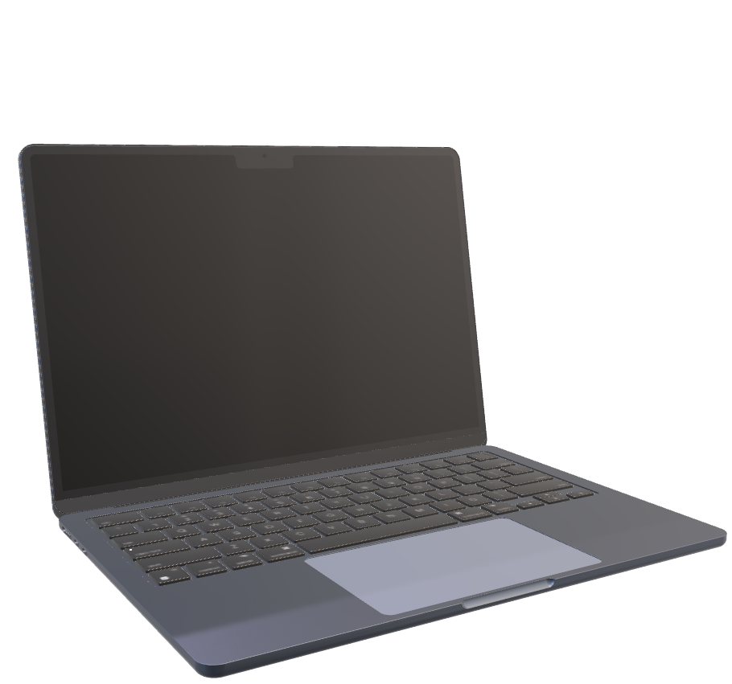

Slide 43
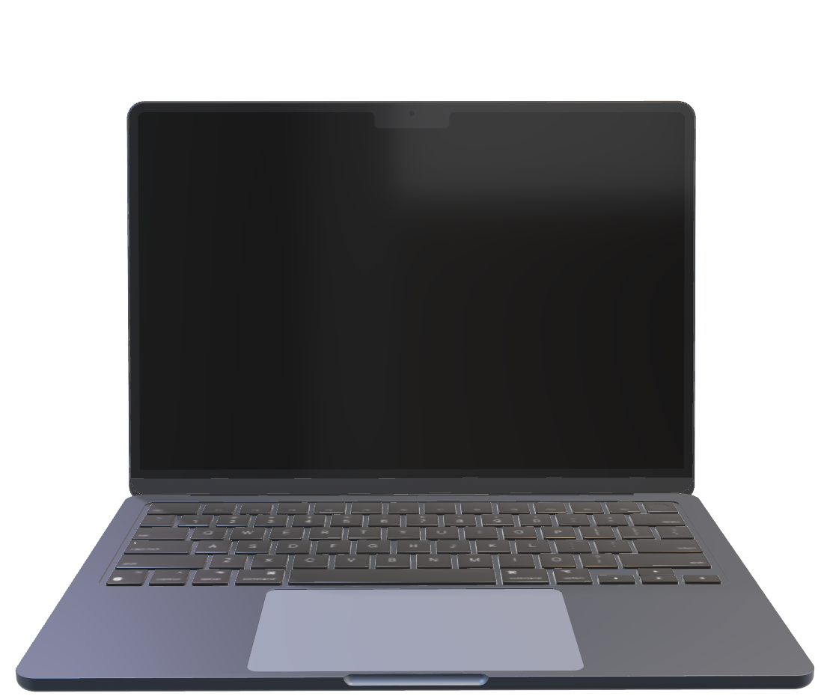

Slide 44




What happens behind the scenes?
Future work:
API Integration for E-Commerce Platforms: We want to enable fashion websites to easily integrate the virtual try-on system through an API or plugin.
Future Work: Develop a GraphQL endpoint for garment try-on / Add "Try It On" buttons next to product listings.
Complete Outfit Generation (Outfit Recommendation Engine): Recommend full outfit sets -e.g., top + pants + shoes + accessories.
Viewpoint Control: Integrate 3D human body models or pose-guided synthesis to support:
Future work:
Dataset with more garments.
Let the system complete a look based on the garment the user is trying on using compatibility model like FashionNet
Add a "Complete This Look" button below the try-on result.
We did this essentially because: Images may look completely black or white, colors might be inverted or washed out and GUI may crash if passed unsupported formats.
Denormalize the pixel values.
Remove Batch Dimension: The model outputs tensor shape [1, 3, H, W]. so we remove the 1 tensor so the image would be displayable. To process the image, we "squeeze" which outputs shape [3, H, W].
Convert to Image Format (PIL)
References
https://capitaloneshopping.com/research/average-retail-return-rate,2025
https://capitaloneshopping.com/research/retail-statistics , 2025
https://www.retaildive.com/news/virtual-try-on-offers-more-sales-perfect-corp/723798/ , 2025

Slide 45
Conclusion:
Future work:
API Integration for E-Commerce Platforms: We want to enable fashion websites to easily integrate the virtual try-on system through an API or plugin.
Future Work: Develop a GraphQL endpoint for garment try-on / Add "Try It On" buttons next to product listings.
Complete Outfit Generation (Outfit Recommendation Engine): Recommend full outfit sets -e.g., top + pants + shoes + accessories.
Multiple viewpoints (side, back).
Viewpoint Control: Integrate 3D human body models or pose-guided synthesis to support:
Allow customers to try on clothes using their live camera or uploaded selfie.
Integrate pose estimation and background removal directly in-browser
Future work:
Dataset with more garments.
Let the system complete a look based on the garment the user is trying on using compatibility model like FashionNet
Add a "Complete This Look" button below the try-on result.
References
https://capitaloneshopping.com/research/average-retail-return-rate,2025
https://capitaloneshopping.com/research/retail-statistics , 2025
https://www.retaildive.com/news/virtual-try-on-offers-more-sales-perfect-corp/723798/ , 2025

Slide 46

Questions:
Conclusion:
Why did you resize all images to 256x192? Would using higher resolution improve the results?
Multiple viewpoints (side, back).
Viewpoint Control: Integrate 3D human body models or pose-guided synthesis to support:
Our project successfully demonstrates the viability of integrating virtual try-on into retail environments. It has the potential to reduce product return rates, improve customer satisfaction, and enhance the overall online shopping experience by helping users make more confident, informed purchasing decisions.
Our work highlights how deep learning and computer vision can be practically applied to solve real-world problems in the fashion industry, providing both a technological solution and a strong foundation for future innovation in digital retail.
While the system performs effectively in controlled scenarios, there remains significant scope for improvement and expansion .. These enhancements will help turn the project into a production-ready tool used across e-commerce platforms.
Allow customers to try on clothes using their live camera or uploaded selfie.
Integrate pose estimation and background removal directly in-browser
How would you compare your project's realism and usability with other methods to try on?
Did you consider training or fine-tuning the model on new data? Why or why not?

Slide 47
References
Conclusion:
Questions:
Our project successfully demonstrates the viability of integrating virtual try-on into retail environments. It has the potential to reduce product return rates, improve customer satisfaction, and enhance the overall online shopping experience by helping users make more confident, informed purchasing decisions.
Our work highlights how deep learning and computer vision can be practically applied to solve real-world problems in the fashion industry, providing both a technological solution and a strong foundation for future innovation in digital retail.
While the system performs effectively in controlled scenarios, there remains significant scope for improvement and expansion .. These enhancements will help turn the project into a production-ready tool used across e-commerce platforms.
How would you compare your project's realism and usability with other methods to try on?
Did you consider training or fine-tuning the model on new data? Why or why not?
Why did you resize all images to 256x192? Would using higher resolution improve the results?

Slide 48
References
Questions:
[1] Xintong Han, Zuxuan Wu, Zhe Wu, Ruichi Yu, and Larry S. Davis. VITON: An Image-based Virtual Try-on Network. In Proceedings of the IEEE/CVF Conference on Computer Vision and Pattern Recognition (CVPR) Workshops, 2018.
[2] Bochao Wang, Huabin Zheng, Xiaodan Liang, Yimin Chen, Liang Lin, and Meng Yang. Toward Characteristic-Preserving Image-based Virtual Try-On Network. In Proceedings of the European Conference on Computer Vision (ECCV), 2018.
[3] Zhen Zhu, Sizhe An, Jianwen Jiang, and Bing Li. ClothFlow: A Flow-based Model for Clothed Person Generation. In Proceedings of the IEEE/CVF International Conference on Computer Vision (ICCV), 2019.
[4] Thibaut Issenhuth, J. Mary, and Cl´ement Calauz` enes. Do not mask what you do not need to mask: a parser-free virtual try-on. In ECCV, 2020.
[5] Han Yang, Ruimao Zhang, Xiaobao Guo, Wei Liu, Wang meng Zuo, and Ping Luo. Towards photo-realistic virtual try-on by adaptively generating-preserving image content. In CVPR, 2020.
[6] Matiur RahmanMinar, Thai Thanh Tuan, Heejune Ahn, Paul Rosin, and Yu-Kun Lai. Cp-vton+: Clothing shape and texture preserving image-based virtual try-on. In CVPRW, 2020.
[7] Sen He, Yi-Zhe Song, and Tao Xiang. Style-based global appearance flow for virtual try-on. In Proceedings of the IEEE/CVF Conference on Computer Vision and Pattern Recognition (CVPR), 2022.
[8] Yuying Ge, Yibing Song, Ruimao Zhang, Chongjian Ge, Wei Liu, and Ping Luo. Parser-free virtual try-on via distilling appearance flows. In Proceedings of the IEEE/CVF Conference on Computer Vision and Pattern Recognition (CVPR), 2021.
[9] Aiyu Cui, Xianfang Zeng, and Xiaoming Deng. StreetTryOn: Learning in-the-wild virtual try-on from unpaired person images. In Proceedings of the IEEE/CVF Conference on Computer Vision and Pattern Recognition Workshops (CVPRW), 2024.
Why did you resize all images to 256x192? Would using higher resolution improve the results?
How would you compare your project's realism and usability with other methods to try on?
Did you consider training or fine-tuning the model on new data? Why or why not?

Slide 49
References
Thank You for listening
[1] Xintong Han, Zuxuan Wu, Zhe Wu, Ruichi Yu, and Larry S. Davis. VITON: An Image-based Virtual Try-on Network. In Proceedings of the IEEE/CVF Conference on Computer Vision and Pattern Recognition (CVPR) Workshops, 2018.
[2] Bochao Wang, Huabin Zheng, Xiaodan Liang, Yimin Chen, Liang Lin, and Meng Yang. Toward Characteristic-Preserving Image-based Virtual Try-On Network. In Proceedings of the European Conference on Computer Vision (ECCV), 2018.
[3] Zhen Zhu, Sizhe An, Jianwen Jiang, and Bing Li. ClothFlow: A Flow-based Model for Clothed Person Generation. In Proceedings of the IEEE/CVF International Conference on Computer Vision (ICCV), 2019.
[4] Thibaut Issenhuth, J. Mary, and Cl´ement Calauz` enes. Do not mask what you do not need to mask: a parser-free virtual try-on. In ECCV, 2020.
[5] Han Yang, Ruimao Zhang, Xiaobao Guo, Wei Liu, Wang meng Zuo, and Ping Luo. Towards photo-realistic virtual try-on by adaptively generating-preserving image content. In CVPR, 2020.
[6] Matiur RahmanMinar, Thai Thanh Tuan, Heejune Ahn, Paul Rosin, and Yu-Kun Lai. Cp-vton+: Clothing shape and texture preserving image-based virtual try-on. In CVPRW, 2020.
[7] Sen He, Yi-Zhe Song, and Tao Xiang. Style-based global appearance flow for virtual try-on. In Proceedings of the IEEE/CVF Conference on Computer Vision and Pattern Recognition (CVPR), 2022.
[8] Yuying Ge, Yibing Song, Ruimao Zhang, Chongjian Ge, Wei Liu, and Ping Luo. Parser-free virtual try-on via distilling appearance flows. In Proceedings of the IEEE/CVF Conference on Computer Vision and Pattern Recognition (CVPR), 2021.
[9] Aiyu Cui, Xianfang Zeng, and Xiaoming Deng. StreetTryOn: Learning in-the-wild virtual try-on from unpaired person images. In Proceedings of the IEEE/CVF Conference on Computer Vision and Pattern Recognition Workshops (CVPRW), 2024.

